Slide 1
Transformers
Introduction to Transformers

Slide 2

Reminder: transformer language model

Slide 3
The residual stream: each token gets passed up and modified
Single Transformer Block
We'll need nonlinearities, so a feedforward layer
Layer norm: the vector x_{i} is normalized twice
Notes:
Technically this is the prenorm arechitrecture; there is an older "postnorm" architecture with the layer norms after the feedforward.

Slide 4
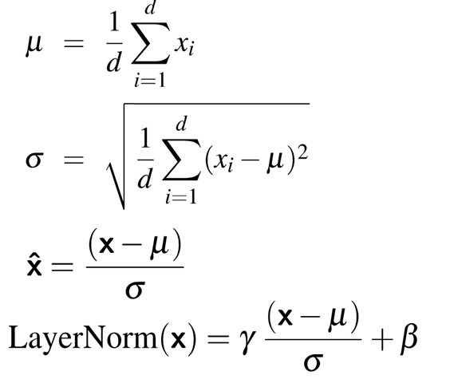
Layer Norm
Layer norm is a variation of the z-score from statistics, applied to a single vec- tor in a hidden layer
Notes:
the term layer norm is a bit confusing; layer norm is not applied to an entire transformer layer, but just to the embedding vector of a single token. Thus the input to layer norm is a single vector of dimensionality d and the output is that vector normalized, again of dimensionality d

Slide 5
Putting together a single transformer block

Slide 6
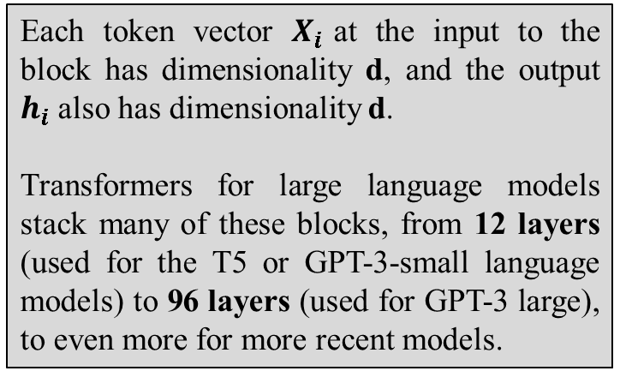
A transformer is a stack of these blocks so all the vectors are of the same dimensionality d
Each token vector $X_{i}$at the input to the block has dimensionality d, and the output $h_{i}$ also has dimensionality d.
Transformers for large language models stack many of these blocks, from 12 layers (used for the T5 or GPT-3-small language models) to 96 layers (used for GPT-3 large), to even more for more recent models.
Block 2
Block 1

Slide 7
Residual streams and attention
Notice that all parts of the transformer block apply to 1 residual stream (1 token).
Except attention, which takes information from other tokens
Elhage et al. (2021) show that we can view attention heads as literally moving information from the residual stream of a neighboring token into the current stream .

Slide 8
Parallelizing computation using X
For attention/transformer block we've been computing a single output at a single time step i in a single residual stream.
But we can pack the N tokens of the input sequence into a single matrix X of size [N × d].
Each row of X is the embedding of one token of the input.
X can have 1K-32K rows, each of the dimensionality of the embedding d (the model dimension)

Slide 9
QK^{T}
Now can do a single matrix multiply to combine Q and K^{T}

Slide 10
Parallelizing attention
Scale the scores, take the softmax, and then multiply the result by V resulting in a matrix of shape N × d
An attention vector for each input token

Slide 11
Masking out the future
What is this mask function? QK^{T} has a score for each query dot every key, including those that follow the query.
Guessing the next word is pretty simple if you already know it!

Slide 12
Masking out the future
Add –∞ to cells in upper triangle
The softmax will turn it to 0

Slide 13
Another point: Attention is quadratic in length

Slide 14
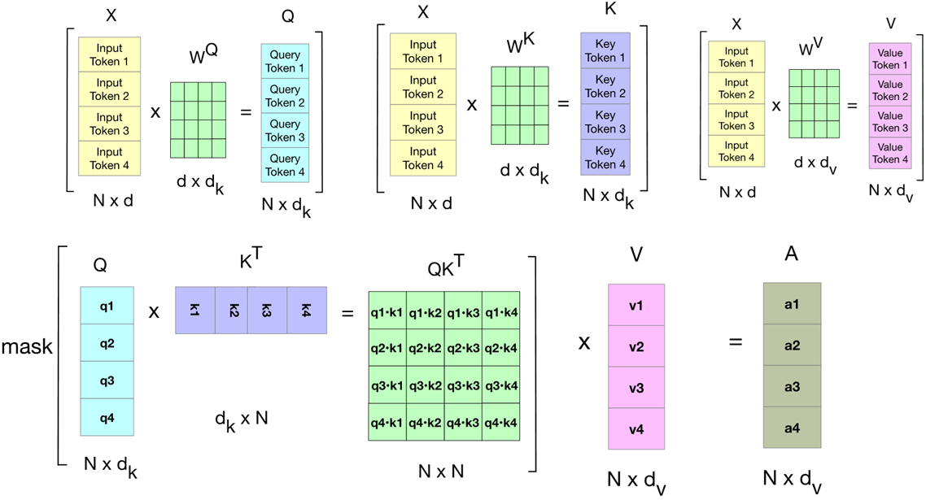
Attention again

Slide 15
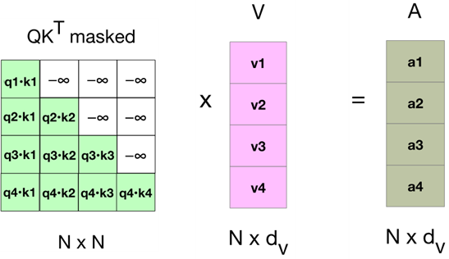
Attention again

Slide 16
Parallelizing Multi-head Attention

Slide 17
Parallelizing Multi-head Attention
or

Slide 18
Token and Position Embeddings
The matrix X (of shape [N × d]) has an embedding for each word in the context.
This embedding is created by adding two distinct embedding for each input
token embedding
positional embedding

Slide 19
Token Embeddings
Embedding matrix E has shape [|V | × d ].
One row for each of the |V | tokens in the vocabulary.
Each word is a row vector of d dimensions
Given: string "Thanks for all the"
1. Tokenize with BPE and convert into vocab indices
w = [5,4000,10532,2224]
2. Select the corresponding rows from E, each row an embedding
(row 5, row 4000, row 10532, row 2224).

Slide 20
Position Embeddings
There are many methods, but we'll just describe the simplest: absolute position.
Goal: learn a position embedding matrix Epos of shape [1 × N ].
Start with randomly initialized embeddings
one for each integer up to some maximum length.
i.e., just as we have an embedding for token fish, we’ll have an embedding for position 3 and position 17.
As with word embeddings, these position embeddings are learned along with other parameters during training.

Slide 21
Each x is just the sum of word and position embeddings

Slide 22
Language modeling head

Slide 23
Language modeling head
Unembedding layer: linear layer projects from h^{L}_{N} (shape [1 × d]) to logit vector
Why "unembedding"? Tied to E^{T}
Weight tying, we use the same weights for two different matrices
Unembedding layer maps from an embedding to a 1x|V| vector of logits

Slide 24
Language modeling head
Logits, the score vector u
One score for each of the |V | possible words in the vocabulary V . Shape 1 × |V |.
Softmax turns the logits into probabilities over vocabulary. Shape 1 × |V |.

Slide 25
The final transformer model

Slide 26
References
https://www.youtube.com/watch?v=KMHkbXzHn7s
https://www.youtube.com/watch?v=bCz4OMemCcA&t=1243s
https://www.youtube.com/watch?v=ZhAz268Hdpw&t=1439s

